Slide 1
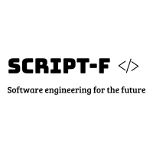
26.4 million

Slide 2
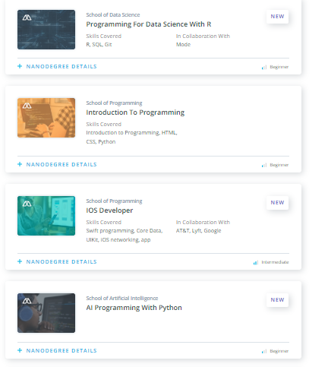
26.4 million

Slide 3
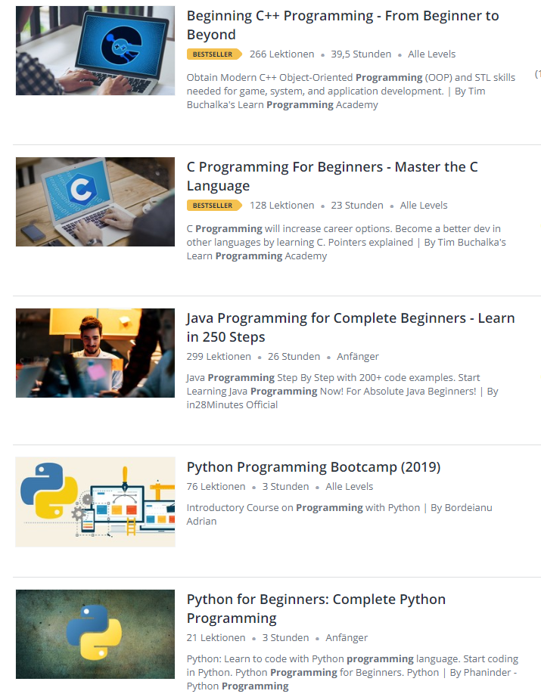
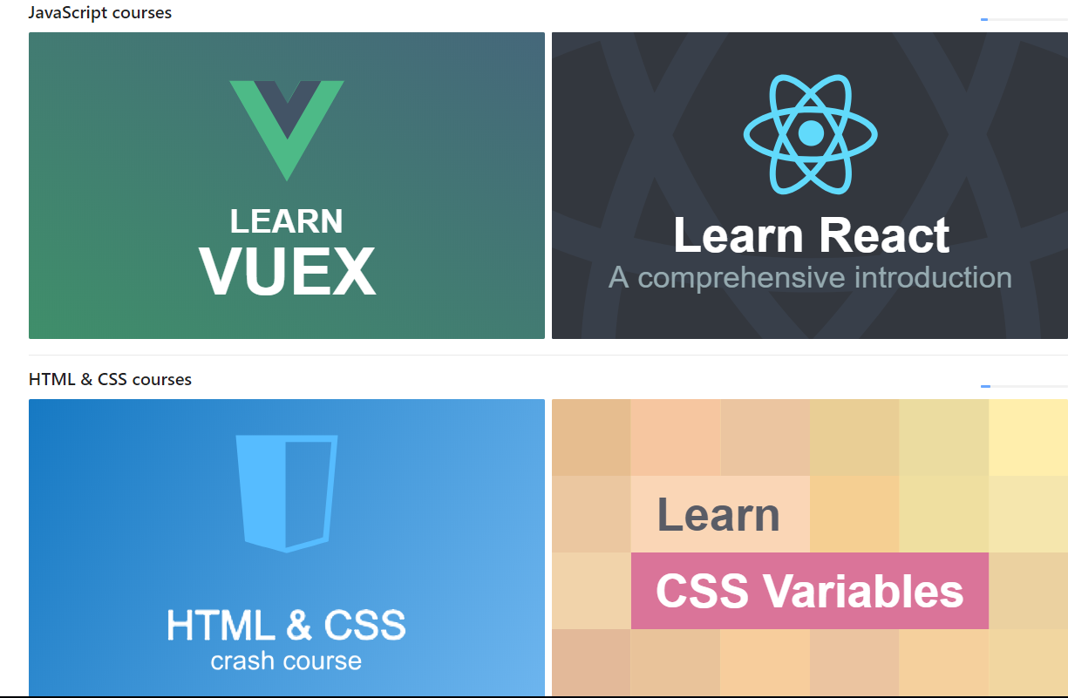
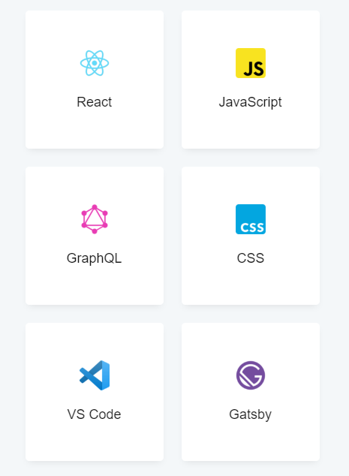
26.4 million

Slide 4
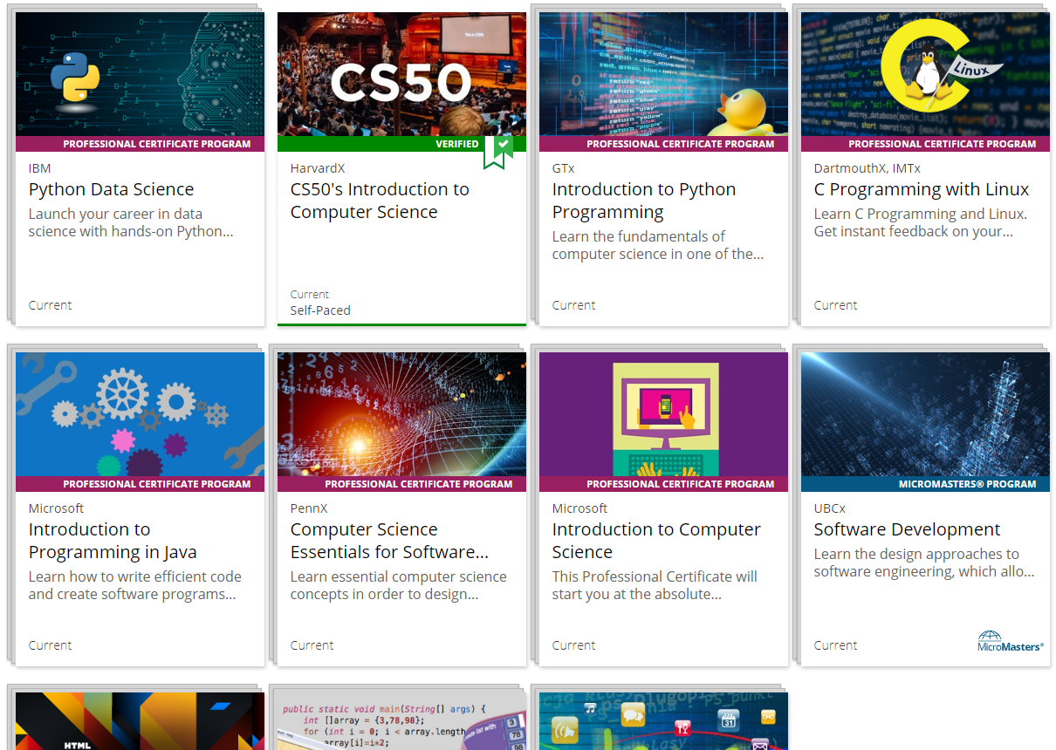
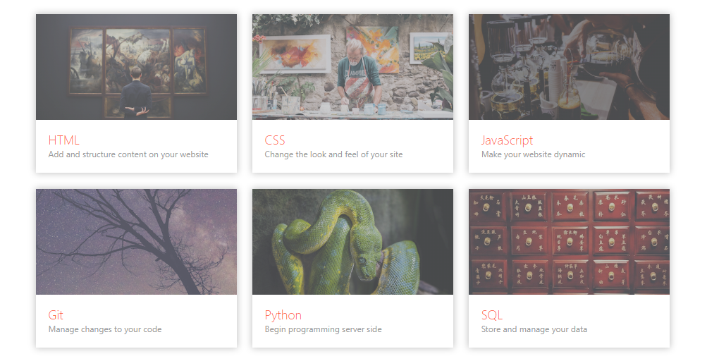
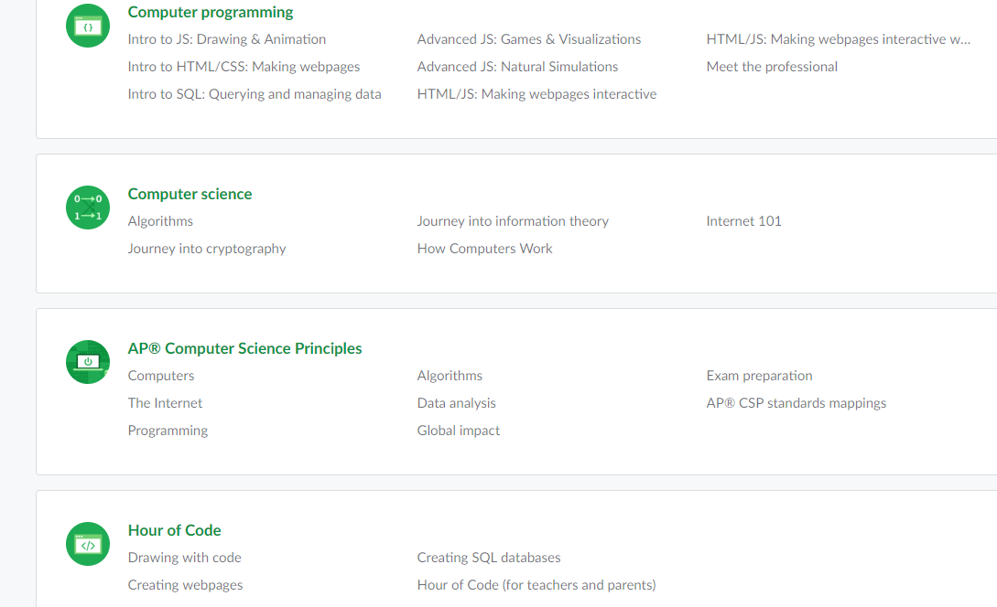
26.4 million

Slide 5
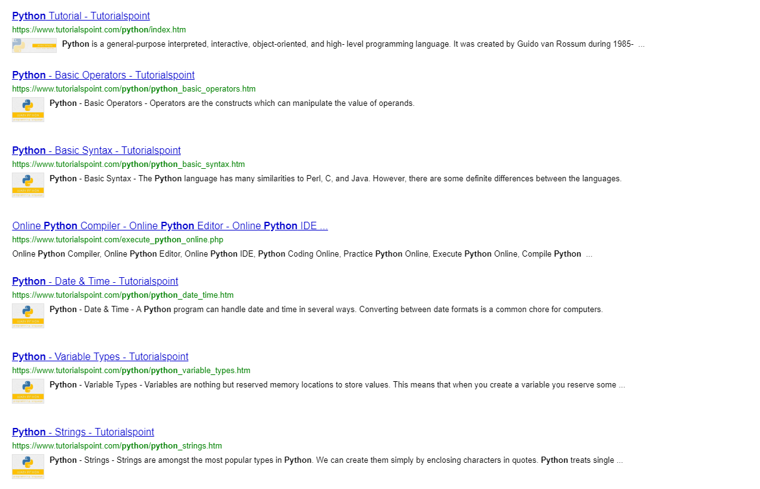
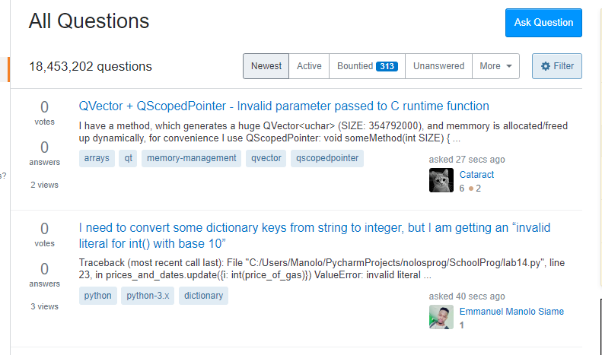
26.4 million

Slide 6


Slide 7
Our solution is based on principles of active learning, in which the learner actively participates in the learning process.
HOW?
Case-based scenarios: developed in-house, by skilled developers and learners
Collaborative tools: i.e. chat tool, “ask for help”, external resources…
Gamification techniques
User-generated content
Feedback from skilled developers who uploaded new scenarios

Slide 8
Our solution is based on principles of active learning, in which the learner actively participates in the learning process.
HOW?
Case-based scenarios: developed in-house, by skilled developers and learners
Collaborative tools: i.e. chat tool, “ask for help”, external resources…
Gamification techniques
User-generated content
Feedback from skilled developers who uploaded new scenarios
→ Take a technology, think of an application you can build with that technology and gain knowledge as you build it.

Slide 9
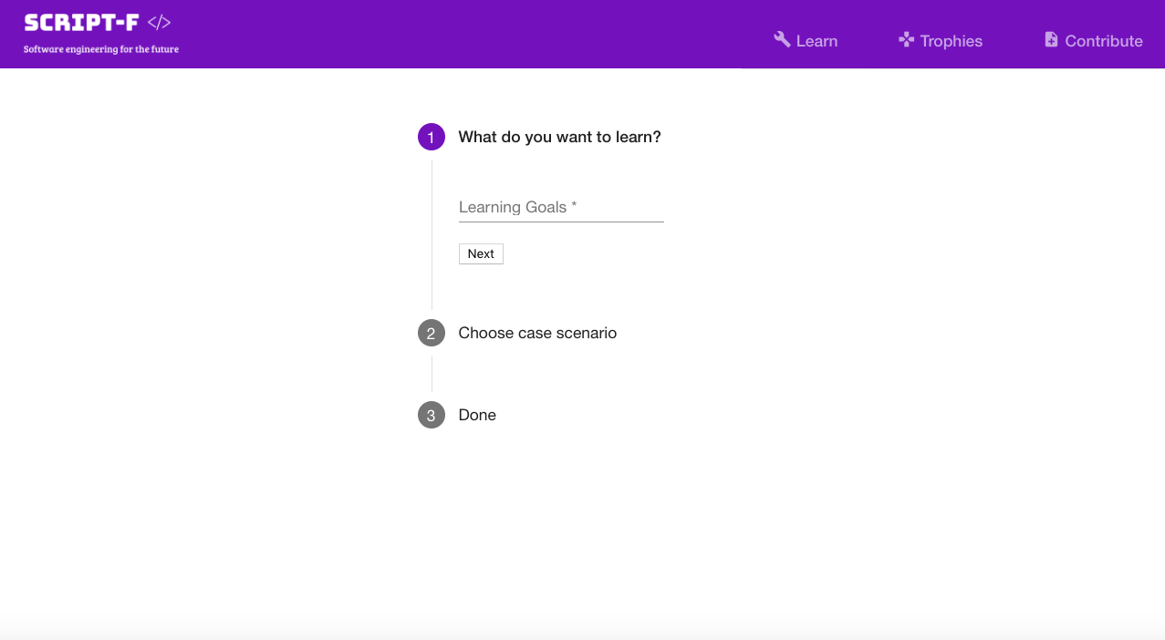

Slide 10
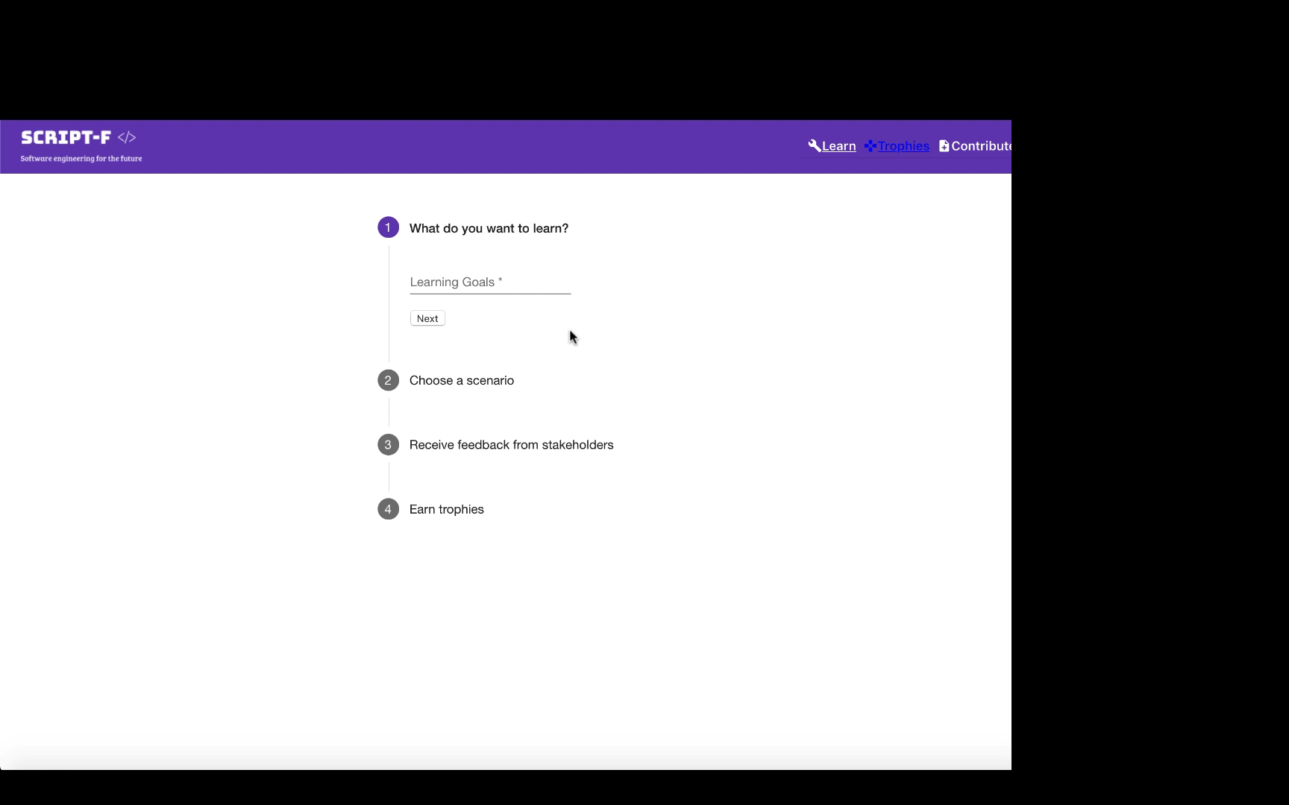

Slide 11
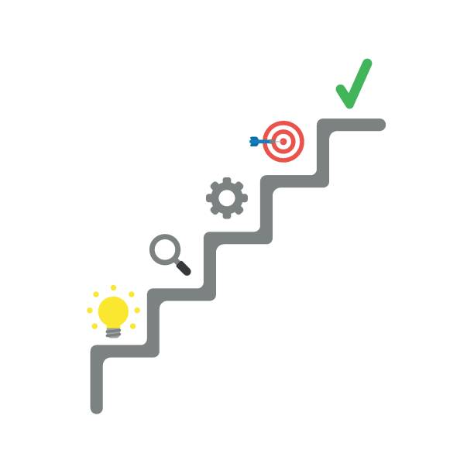
Next steps:
Chatbot functionality
Speech recognition
Peer-to-peer feedback
User competitions with rewards

Slide 12
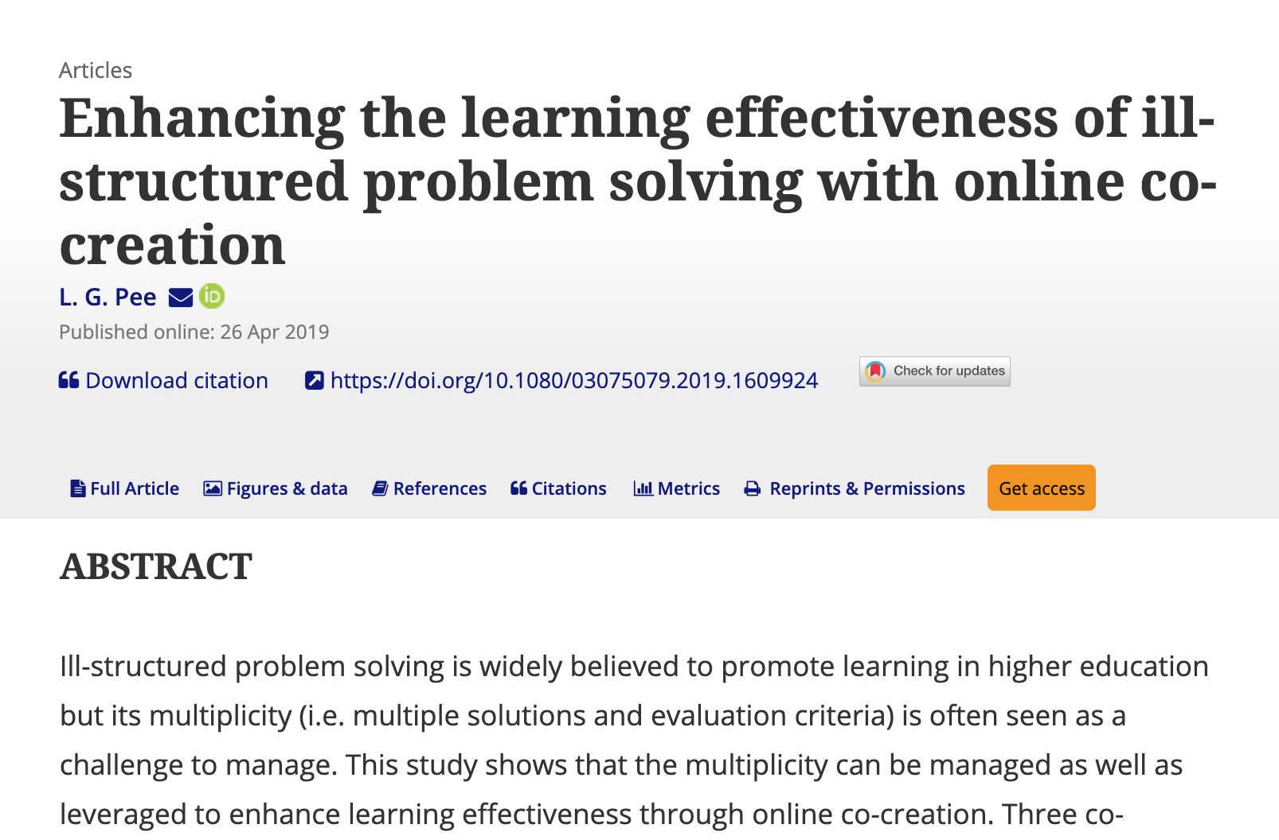
We maximise the learning effect through practical engagement through solution discovery by creating real-world implementations of the learning topics.
the system does not enforce a single correct solution
success will be demonstrated by the actual deployment of the developed application
statistics (tbd) will be shown. May include statistics on speed of achievement, interaction with others, quality of code etc.
https://www.tandfonline.com/doi/abs/10.1080/03075079.2019.1609924

Slide 13
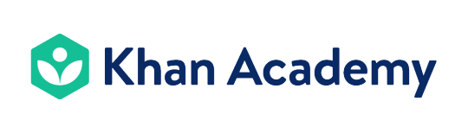
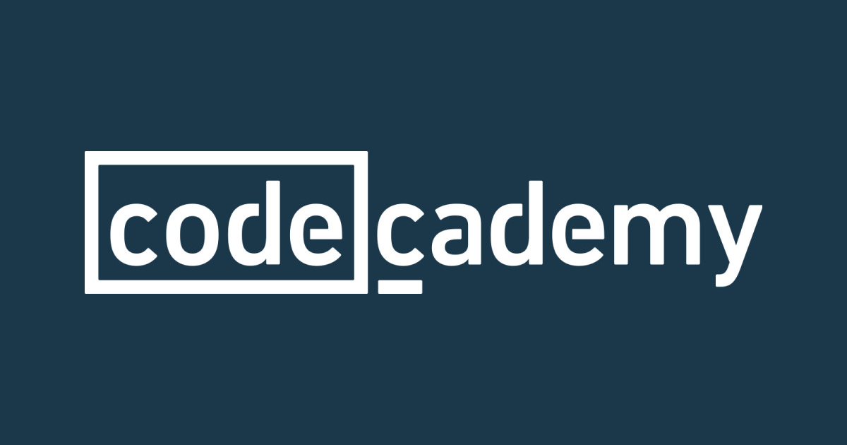
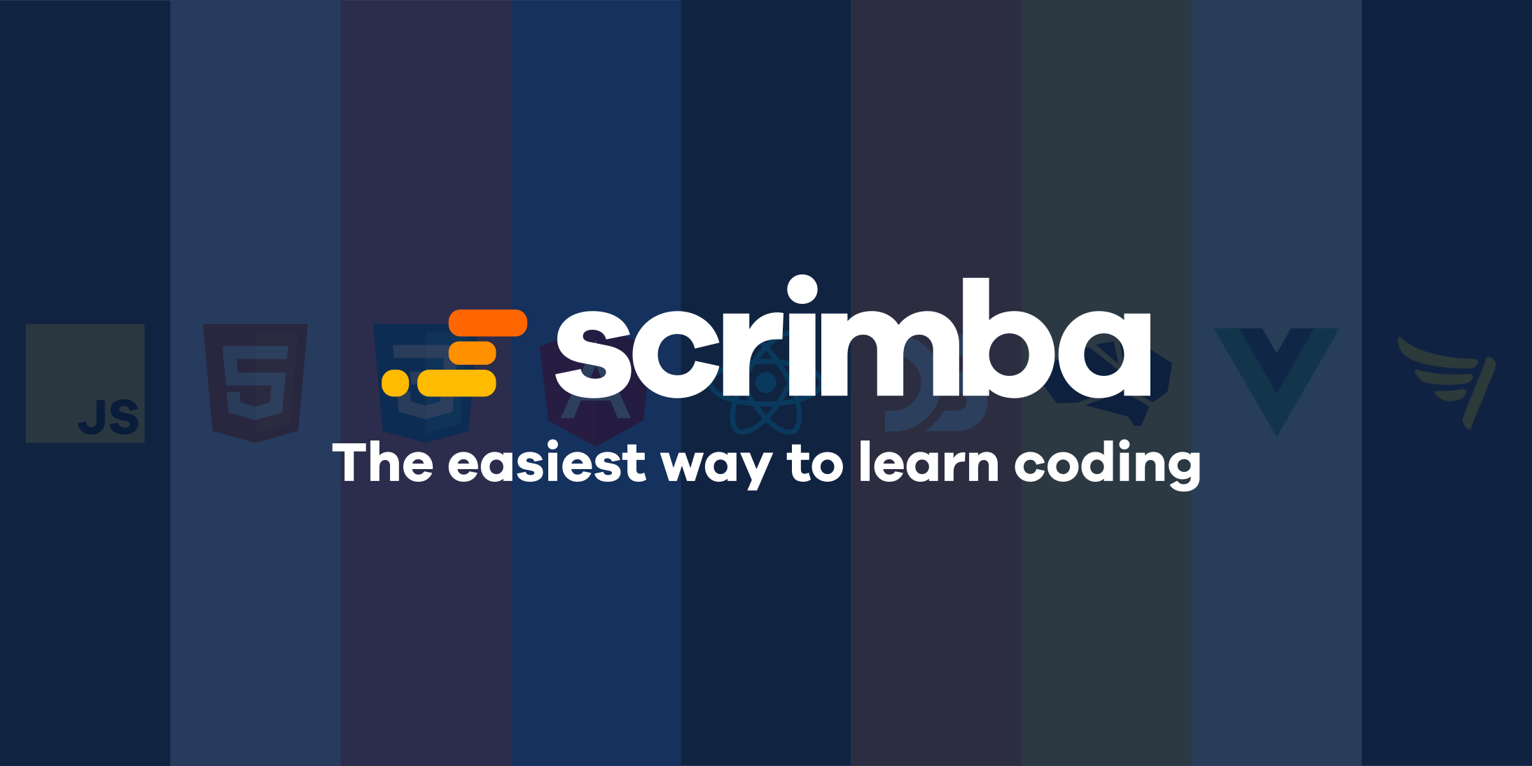






Competitor landscape
Notes:
As the digital transformation is accelerating it is becoming difficult to maintain focus and motivation using a traditional online learning method.

Slide 14
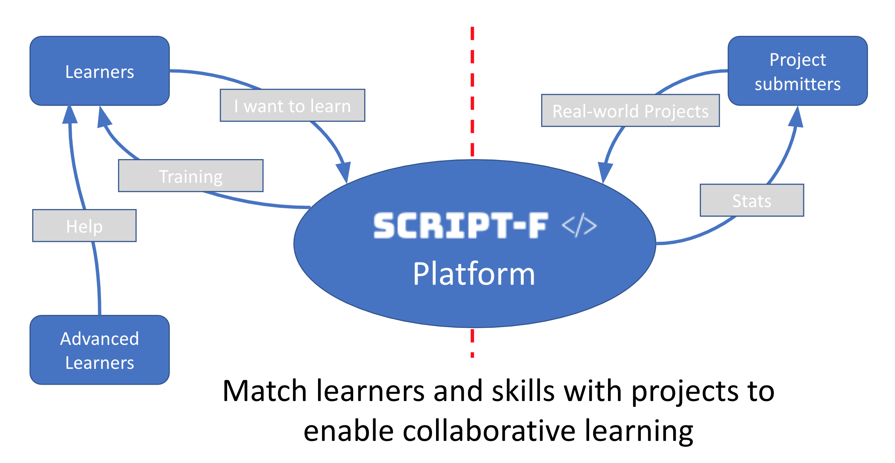

Slide 15
we propose a 2-sided marketplace where learners can join actual projects and apply the learned skills to help create and deploy an actual real-world application. This can then be used as a first portfolio project demonstrating the learner's acquired skills. A lean canvas and the conversations we’ve had show that the initial idea makes sense.
Lean Canvas analysis
Problem
90% of participants don’t finish
applicability to real world setting
Existing alternatives
many offerings but lacking real world rollout of the developed solution
Solution
online education platform
“Ill structured problems”
two sided marketplace: + challengers + learners
Key metrics
ratings
completion rates
Unique value proposition
marketplace keeps engagement
High level concept
educational offerings with real-world applications provided by crowd contributions
Unfair advantage
Accenture’s reach
Channels
- bring in your own team participants
Accenture, influencer marketing, affiliates
Customer segment
skill updates for tech consulting employees
new hires
early adopters
internal workforce
Cost structure
- operation of a mobile/web platform
Revenue streams
subscriptions
licenses

Slide 16
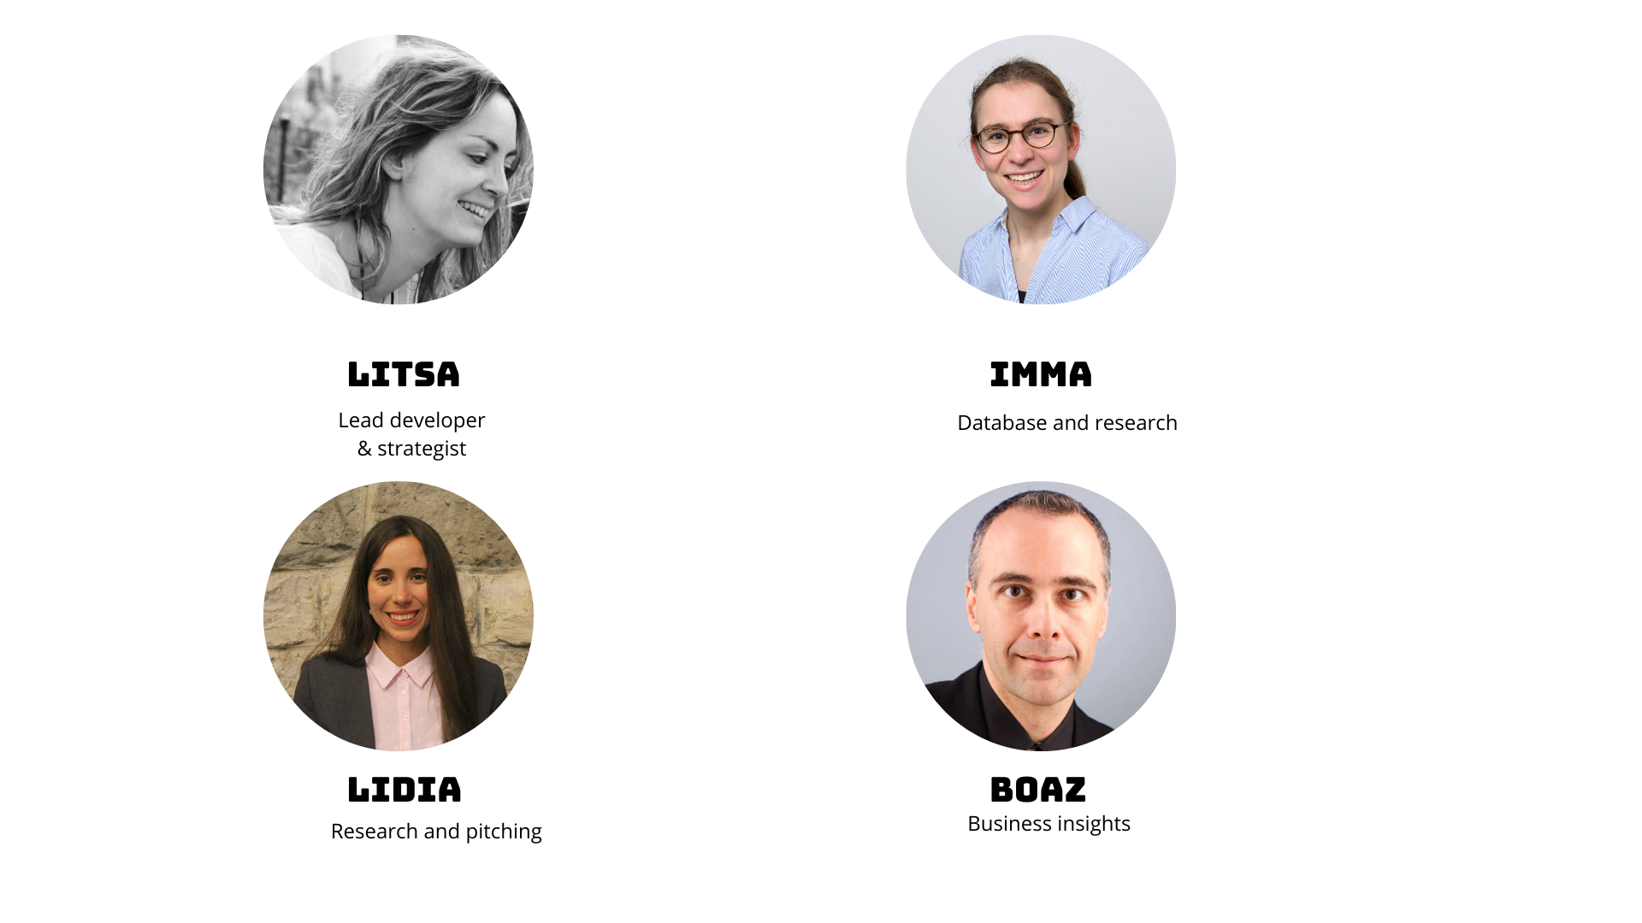
Our multidisciplinary team:

Slide 17
Appendix
Screenshots

Slide 19
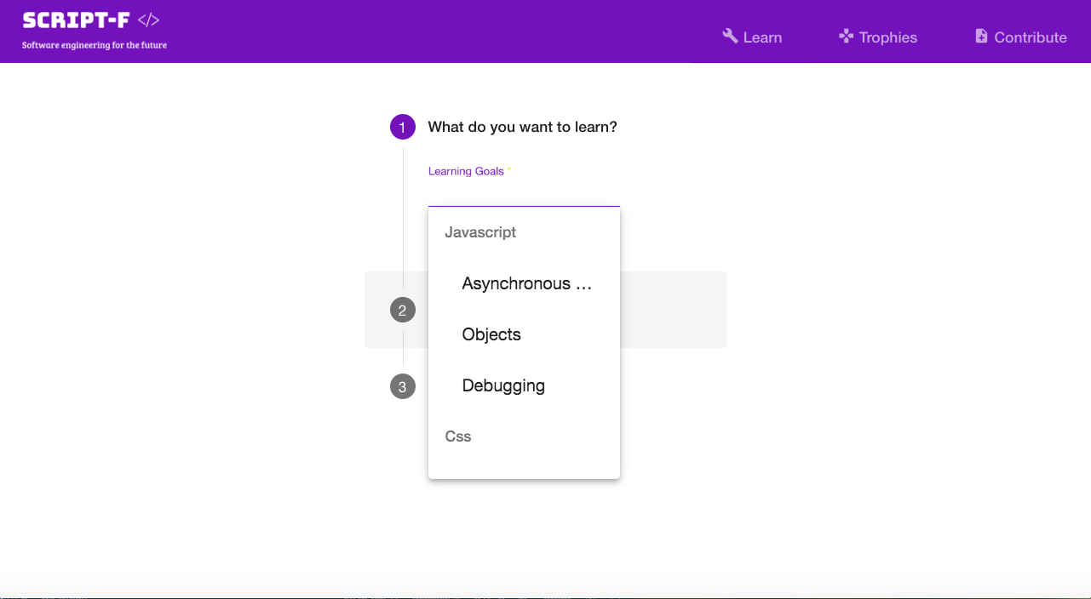

Slide 20
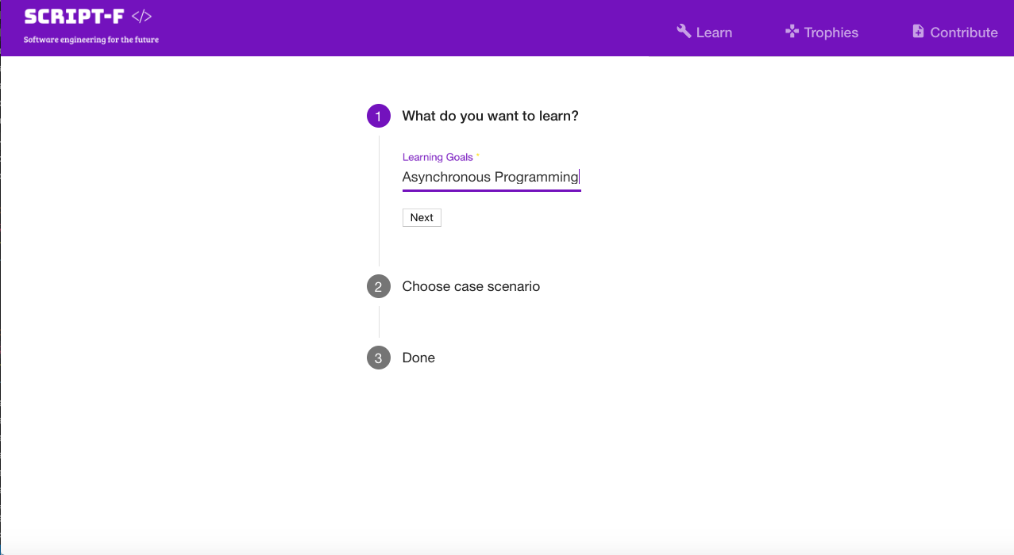

Slide 21
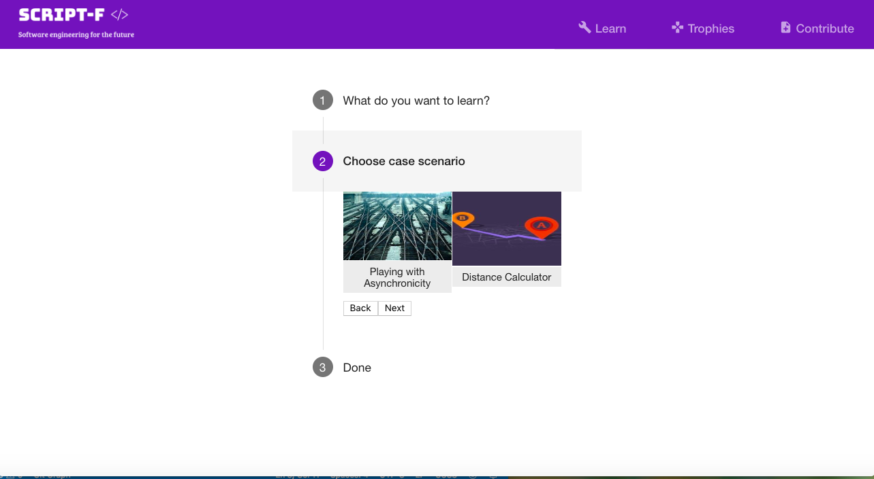

Slide 22
